Slide 1
CAP OWNED VEHICLE (COV) ORIENTATION
Prepared MAY 2023 by New York Wing

Slide 2
Introduction
This presentation is designed to provide every CAP driver who will operate a Corporate Owned Vehicle (COV) with specific information for his/her successful and safe use of the asset.
All CAP drivers are required to view this presentation as well as to read CAPR 77-1 and any NYWG CAPR 77-1 Supplement.
Drivers must review the COV Binder in the COV prior to usage.

Slide 3
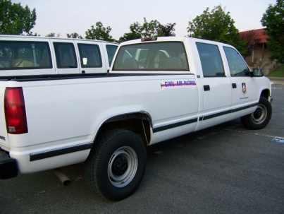
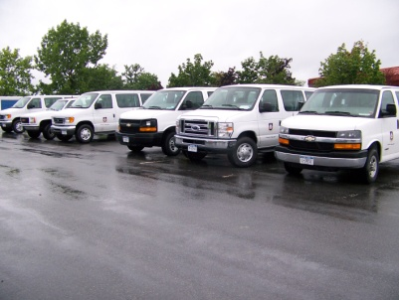
COV
Corporate Owned Vehicle (COV). Any wheel-mounted vehicle or trailer for highway or land use, owned by and titled in the name of Civil Air Patrol.
CAPR 77-1 Operation and Maintenance of CAP Vehicles

Slide 4
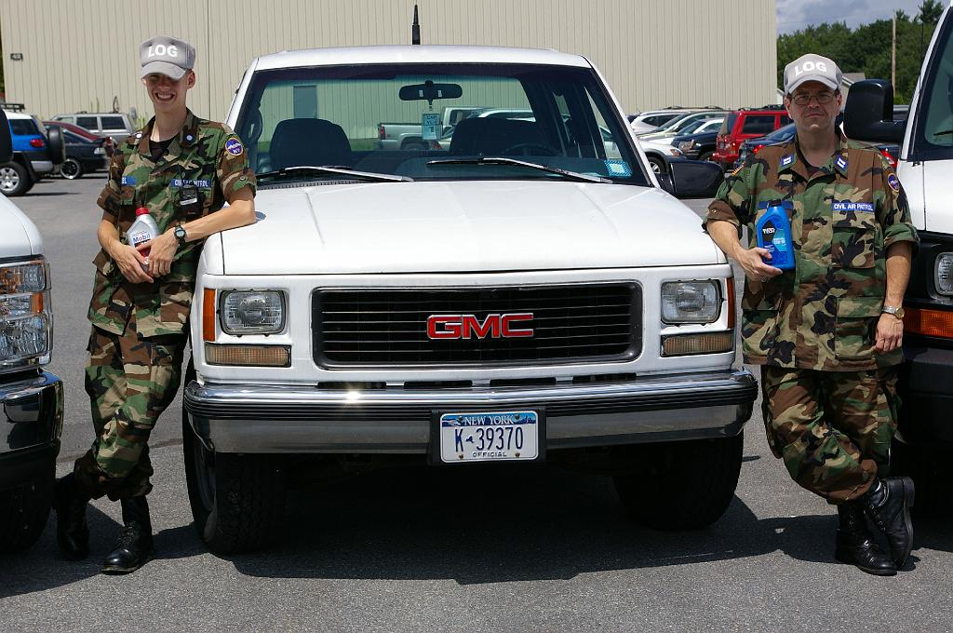
CAP Mobile Assets
Aircraft
Trailers
Ground Vehicles
Cars
Vans
Trucks

Slide 5
First-Things-First
Operating a CAP COV is a privilege; not a right.
All CAP regulations, national, regional and wing level must be complied with.
Wing logistic directors have the authority of managing all wing assets including COVs.
Any member driving a CAP COV must have a valid State Diver’s License and CAP driving permissions listed on their CAPF 101 card.
All COV Drivers must read the COV Binder in the COV and be familiar with its contents and updates prior to starting engine. Radio, EFS Credit Card, Registration, Insurance and Safety Information are in the binder with CAPF 73s.

Slide 6
EFS Credit Card Usage
EFS CREDIT CARD INSTRUCTIONS
Each powered COV within New York Wing has a EFS Credit Card assigned to it.
The individual cards are coded to the COV to which they are assigned and may not be used for any other vehicle.
The EFS Card can only be used for three (3) reasons:
To purchase fuel and lubricants consumed during an authorized/reimbursable mission entered into WIMRS.
In special cases use of the credit cards for fuel may be approved by: Wing CC, CV, DO, LG or LGT
To purchase approved standard COV maintenance services and parts.

Slide 7
EFS Credit Card Usage (cont’d)
Fuel expenses for authorized reimbursable missions must be uploaded in WIMRS by end the day used. EFS Fuel Sales Receipt must be forwarded to NYWG/DO(A) within 24 hours. Email accepted.
Purchase of standard COV maintenance and service over $250.00 must be preapproved either in writing or verbally by NYWG/LG or NYWG/LGT. Standard Maintenance under $ 250.00 does not require prior approval. Copy of paid work order and EFS Credit Card Receipt must be forwarded to NYWG/LGT within 24 hours. Email accepted.

Slide 8
EFS Credit Card Usage (cont’d)
Fuel and maintenance costs may not be combined into one transaction.
The card may not be used for any other purchases than those listed above.
If a card becomes lost, stolen, damaged, or inoperative immediately contact NYWG/DO(A) or NYWG/LG by telephone or email.
Mileage and Personal Identification Number (PIN) are required for each transaction.
PIN is 36112 or first 4 numbers of the NYWG COV (Sometimes asks Driver’s ID).

Slide 9
Operating A CAP COV
Drivers must obey all federal, state, commonwealth, local laws, regulations, and ordinances governing the operation of motor vehicles.
While operating vehicles, both COV and Personal (POV), drivers must obey all military or governmental vehicle regulations especially speed and stop signs.
Headlights turned on in daylight hours.

Slide 10
Operating A CAP COV Cont’d
Seat belts must be fastened for the driver and all passengers within up to the applicable max number of passengers allowable, i.e. 11 PAX, 7 PAX). Doors closed and locked.
No tobacco or e-Cig vapor products usage permitted in any CAP COV.
No hand-held cellular phones or texting devices by driver while operating COVs.
At the end of use, the driver is responsible for seeing that the vehicle is fully fueled, clean, and ready for the next user.

Slide 11
How to Obtain CAP Driver Privileges
1. You must posses a valid state drivers license.
2. You must obtain your Driver’s License Abstract from your state’s Department of Motor Vehicles (DMV).

Slide 12
Obtaining CAP Driver Privileges Cont’d.
3. You must be 21 or older with three years driving experience.
4. You must be Safety Current. (See CAPSIS)
5. You must be a member in good standing and have completed Level I Training.

Slide 13
Obtaining CAP Driver Privileges Cont’d
6. You must hold a duty position within a Squadron, Group or Wing.
7. You must use the online process in
e-Services OPS QUALS for requesting
CAP Driver’s Driver Privileges.
8. You must scan and upload a copy of your valid state drivers license and an official DMV Abstract into e-Services OPS QUALS (abstract must be within 60 days of application).

Slide 14
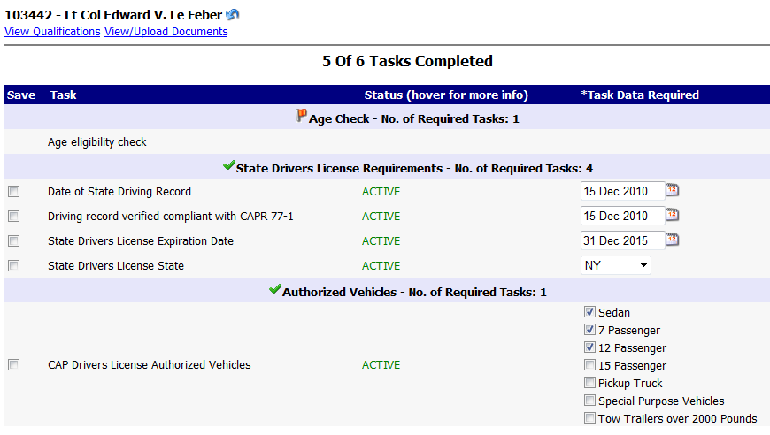

Slide 15
Obtaining CAP Driver Privileges Cont’d
9. Your unit commander or unit transportation officer must approve your request in e-Services OPS QUALS.
8. The unit commander or unit transportation officer verifies the information and either approves or disapproves the request. Approval is then forwarded to wing.

Slide 16
Obtaining CAP Driver Privileges Cont’d
9. The Wing Logistics Director, Wing Transportation Officer, or Assistant Transportation Officer checks the information for accuracy and will either approve or disapprove.
10. When approved, your CAP Driver Privileges will show under your Operations Qualifications CAPF101 Card. Print card and carry with you.

Slide 17
Obtaining a CAP Driver Privileges Cont’d.
Securing Driver Privileges for Special Purpose Vehicles or Towing Privileges requires additional proof/documentation with possible testing to be presented to Wing Logistics Director, Transportation Officer, or Assistant Transportation Officer.
This is a separate request after basic privileges are granted.

Slide 18
It is strongly recommended that you take an insurance points and premium reduction defensive driving course whether you have points
on your license or not.

Slide 19
Use of Vehicles at Encampment
What should you do if you need the use of a CAP vehicle
NOTE: CAP members MAY NOT drive any federally owned vehicles: i.e. Bus, Jeep, Staff Car, Truck, etc.
Gain permission from Encampment Transportation Officer.

Slide 20
Use of Vehicles at Encampment Cont’d
Complete daily inspection per CAPF 73, (you must do so before vehicle use as per CAP regulations found in CAPR 77-1).
Report usage as 24 hours per day while at an encampment or any overnight CAP activity.

Slide 21
Safety
Vehicle Safety Inspection
Any items not in safe working order, must be replaced/repaired before vehicle is used.
Cargo netting must be used to secure items in rear cargo area of all CAP vans. Cargo may not to exceed top of rear seat nor 300 lbs.

Slide 22
Safety Cont’d
Inspection of vehicle is conducted both inside and outside. Signature (CAPID) on CAPF 73 for daily usage indicates inspection completion.
All vehicle fluids are checked and brought to safe levels or replaced all together.*
Fluids: Oil, power steering, transmission,
coolant, washer fluid.
* Except in sealed transmission systems

Slide 23
CAP Vehicle Inspection Items
Note all external/internal damage, no matter its size or severity.
Check: All engine belts, horn, back up alarm, lights (front and back) and directional indicators (emergency indicators as well); safety devices: seat belts.
First-aid Kits are optional. If installed must be noted on CAPF 73 “Additional Comments” as compliant.

Slide 24
CAP Vehicle Inspection Items Cont’d
Tire pressure – ensure all tires are filled to specified pressure noted on wheel wells or on back door for spares mounted in rear or on driver side rocker panel if installed underneath center consol. Not all COV have spare tires.
Check: Brakes, all instruments, wind-shield wipers, steering, windows, battery condition, radio and antenna mounts.

Slide 25
CAP Vehicle Inspection Items Cont’d
Confirm and note the following:
Valid NY State inspection date - on windshield
Proof of insurance - in binder
Proof of registration - in binder
Fuel level of vehicle - dashboard
NOTE: Mileage –must be reported if on a mission for EFS card usage and for Mission CAPF 109
NOTE: NYS Official Vehicles are registered only once. Registration is for the CAP lifetime of the vehicle. No registration is displayed on any windshield of any vehicle bearing NYS Official Plates.

Slide 26
COV Inspection Updates 2021
The following slides indicate an older CAPF 73.
Only use CAPF 73 dated FEB 2015. (NOV 2003 illustrated)
Be sure to insert CAPID and Signature where indicated.
Whether driven or not, COV must be inspected monthly before
CAPF 73 is uploaded into ORMS.
Under Additional Comments, if applicable, indicate that First Aid Kit has been inspected and is compliant.

Slide 27
CAPF 73 dated FEB 2015

Slide 28
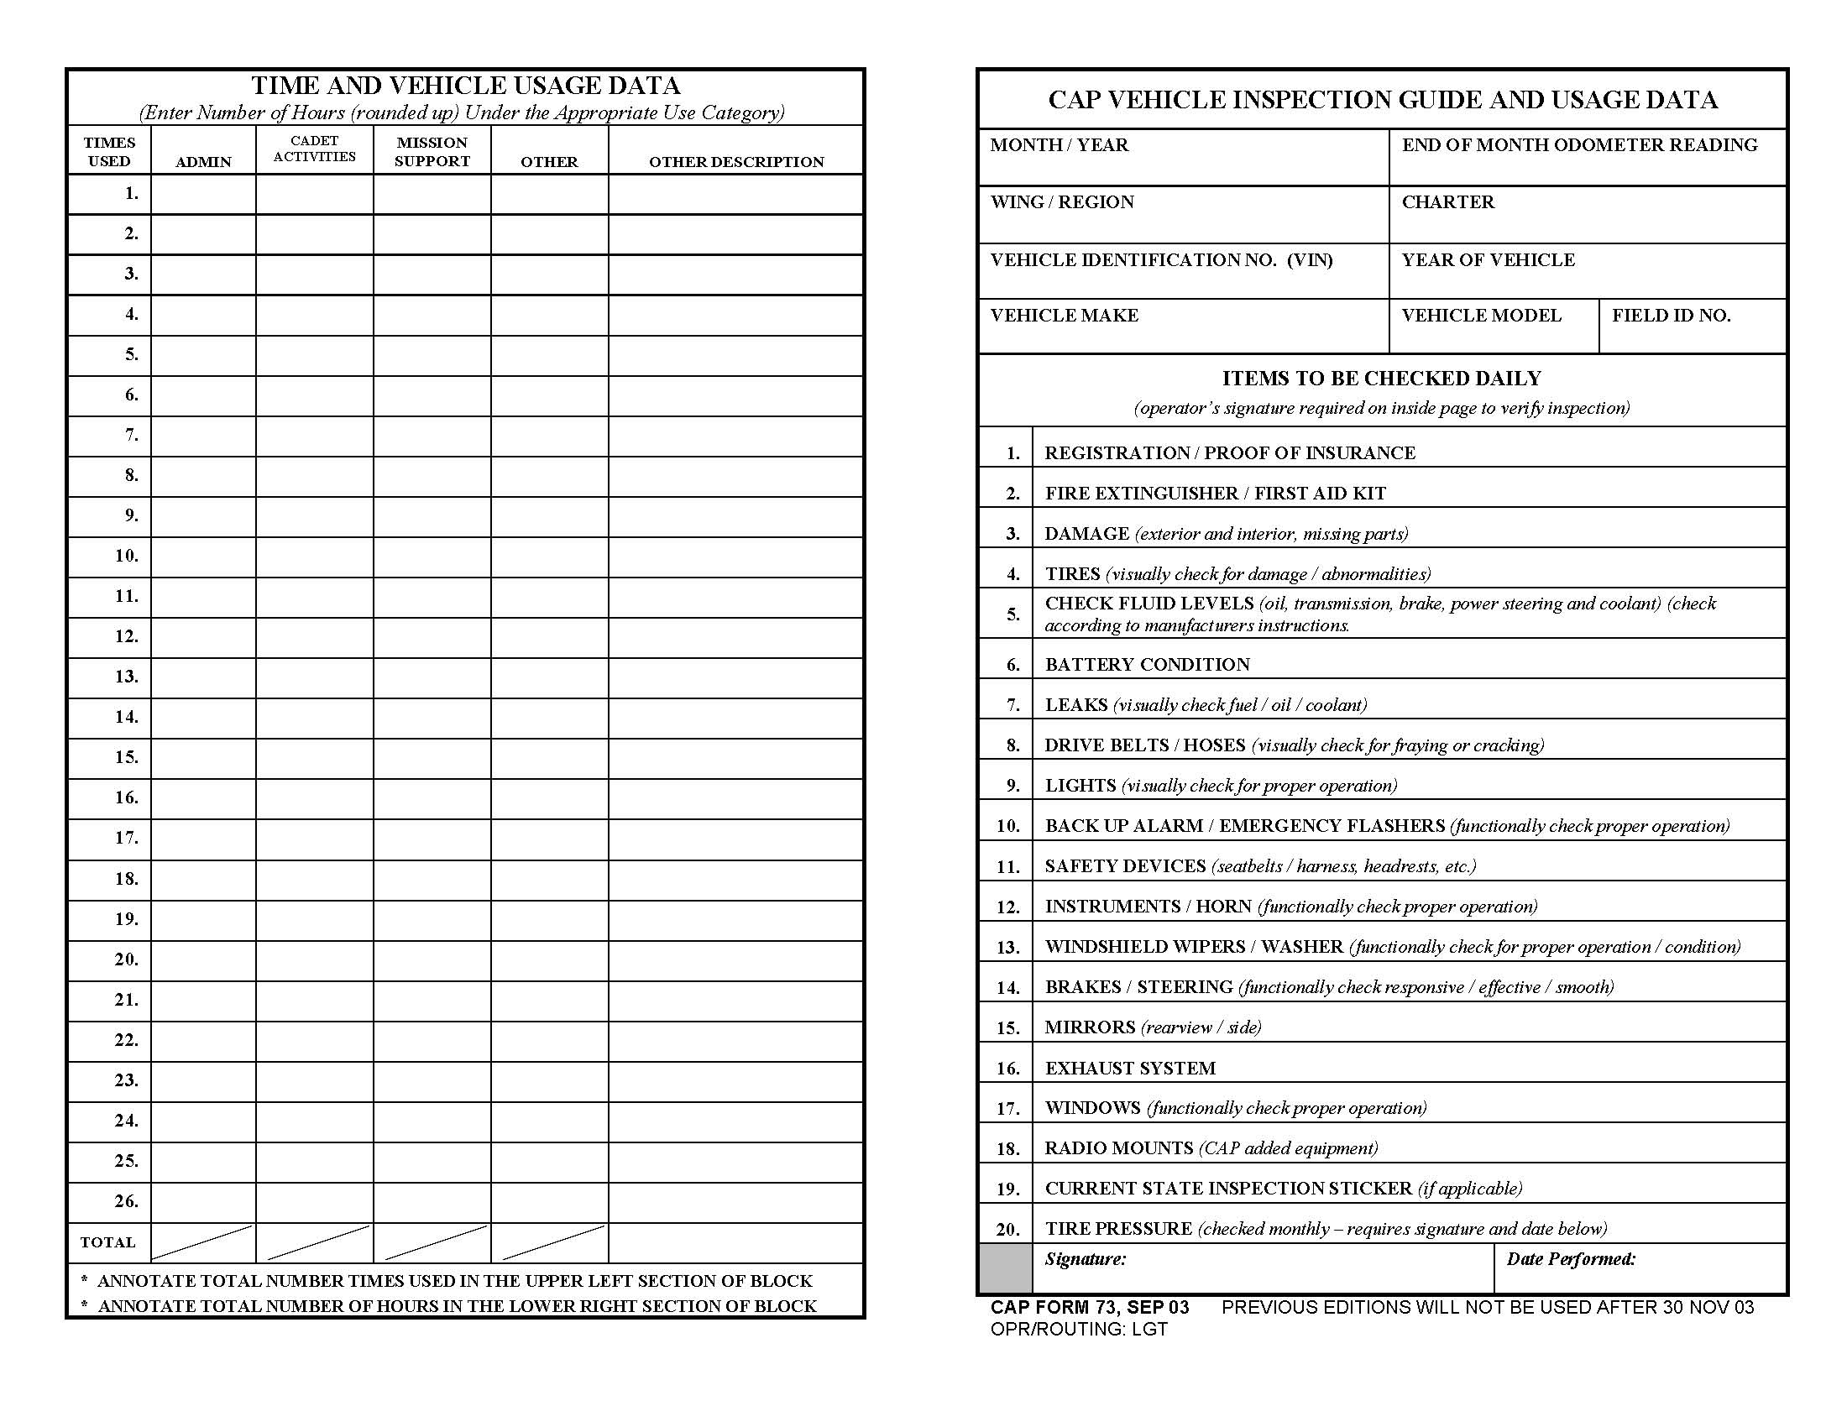
At the beginning…
Enter date as: April 2010
Enter mileage from odometer
Enter just the squadron number. Such as 306, 302 etc
This is the year the van was made – Check the registration
Enter NY/NER”
VIN is from van title, insurance card or registration
Check all 19 items on the safety checklist each time the van is utilized. Item 2 is reserved.
Notes:
This is all accomplished by Transportation Officer . NOTE: Item 2 is blank and Fire extinguisher is noted OK in remarks section.

Slide 29
At the beginning (continued)…
This is the 5 digit Wing assigned #
All NY vans #s start with 31 as in 31XXX
Enter the model. Van, Pick-up, Minivan, 4x4, etc.
Who made the van. Ford, Chevrolet, Dodge
These are the system Item Number you will use on the discrepancy on back left side
This signature/date is for the monthly inspection.

Slide 30
And on the left…
Enter the number of hours the van is used for the entire activity in these blocks rounded up.
This number is the times the van is used, not the date.
Describe any “Other” use in this column – Use this column for van maintenance.
The top part of this block is the sum of all the times used.
The bottom is the sum of all the hours the van is used.

Slide 31
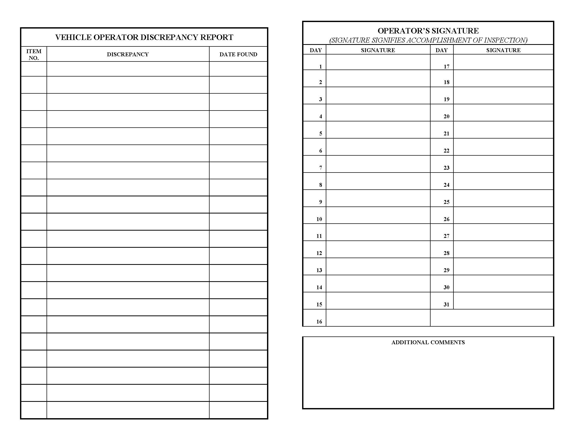
On the back, on the right…
This is the day of the month you use the van
The first driver of the day signs with CAPID here on the date they inspect the vehicle prior to use –This also certifies that all safety checks 1 through 19 have been completed
Make any comments here –
note OK for first kit
note maintenance such as oil changes, repair, state inspections, monthly cleaning, waxing, etc.

Slide 32
On the back, on the left…
Enter the system item number from the front right side of this form in this column
Fully explain the problem with the system in this column
Enter the date you find the problem in this column

Slide 33
Example of a properly completed
front Form 73
April 2010
000000
4
3
4
NY/NER
000
8
2
1DEC1941VAN111
2009
Add up the number of hours the van was used here. Note: there may be two or more categories of usage for one day.
Ford
Van
31XXX
Enter the number of times the van was used here
Enter the sum of the hours here
1
4
2
2
11
6
Van Operator 123456
3 Apr 10

Slide 34
CAPR 77-1 VEHICLE USAGE EXAMPLES
Vehicle usage examples: Including but not limited to the following:
(a) ADMIN: Trips to meetings, conferences and personnel transportation to and from airports or hotels.
(b) CADET ACTIVITIES: Any activity pertaining to and involving cadets and cadet programs.
(c) MISSION SUPPORT: Drug Demand Reduction, Counterdrug, Homeland Security, Emergency Services (Search and Rescue/Disaster Relief) and Aerospace Education and Training.
(d) OTHER: Vehicle maintenance, servicing, inspections and repairs, parts and supply pick up.

Slide 35
Example of a properly completed
back Form 73
7
Static oil leak at front of oil pan
3 Apr 10
16
Hole in rear of muffler near top.
NO VAN USE TILL REPAIRED!
3 Apr 10
Driver One 123456
_X_1st AID KIT OK.
Appt Auto Repair Shop 0800 4 Apr 10 to get estimate to repair muffler. Will fax to NYWG HQ for submission to NHQ for review and approval prior to repair.

Slide 36
Vehicle Do’s
Do leave early enough to leave time for traffic and weather conditions
Do drive vehicle ONLY in a safe manner
Do obey all local and base traffic signs
Do carry maps of the local area with you at all times
Do listen to all logistics briefings on vehicle use
Do stop vehicle immediately if you suspect any problems and seek instruction from higher authority – SAFETY FIRST!

Slide 37
More Vehicle Do’s
When backing any COV, especially with
passengers on board, whenever possible,
have an officer stand outside to the rear of
the COV to act as a guide while backing.
Drive with all doors closed and locked.

Slide 38
Vehicle Don’ts
Do not pull away until the vehicle is inspected and all passengers including driver are wearing seat belts.
Do not pull away unless there is enough gas in the vehicle to get to destination with some to spare. COV will be topped off in order to be ready for next usage.
Do not go faster than the posted allowable speed limit.

Slide 39
More Vehicle Don’ts
Do Not apply decaling or signage other than that provided by NHQ.
Do not permit use of tobacco products of any sort within any COV per CAPR 77-1.
Do not use cell phone or text on cell phone when driving. This is a violation of CAPR 77-1 and New York Motor Vehicle Law.

Slide 40
What If?
What if an accident occurs?
Pull off to the side of the road to a safe area.
Immediately contact the Wing Commander, or Vice Commander, and Wing Safety officer. A Mishap Notification must be filed online for all accidents.
Contact Police for accident report regardless of how minor the damage may appear.

Slide 41
What if? Cont’d
Fill out NYS MV 104 Form provided in binder.
Be sure to document the date, time, and the
other driver’s license, registration and as
much additional information as possible.
What if emergency repairs are needed?
After all above is completed, contact the Wing
Logistics Director or Wing Transportation
Officer for instructions.

Slide 42
Summary
SAFETY FIRST at all times
Obey all traffic signs
Inspect vehicles daily – ensure adequate fluid levels and correct tire pressure (indicated above the wheel well above each tire)
Meet all standards
Wear seat belts at all times
Ask if your unsure of anything
Vehicle MUST be returned clean, FULLY FUELED and MISSION READY !!!!!!!!!

Slide 43
Questions

