Slide 1
The Van Driver and You
Proper care and feeding of the van driver and their responsibilities to you
Safety Day 2023 Lt Col Sean Neal, Dir of Safety, NYWG

Slide 2
Driver and passenger roles when using a CAP van
Pre-drive inspection and maintenance check
Parking and backing the vehicle
Rules of the road
Don’t forget the paperwork
The good passenger…
Backing and parking
Lane changes and turns
Navigation and communication
Distractions

Slide 3
The Van Driver(s)
Utilize the I’mSafe Checklist
I-Illness
M-Medications
S-Stress
A-Alcohol
F-Fatigue
E-Emotion (Eating)
Also ensure driver is qualified and familiar with vehicle and differences from pax vehicle. Be aware of the van height including antenna, which will add 18 inches.
Notes:
Illness--If you don’t feel well, don’t drive. Your alertness and reaction time will be decreased as will your patience in dealing with enthusiastic cadets or seniors.
Medication-- Many over the counter medicines and supplements can cause drowsiness, especially allergy and cold medications. If it says to DO NOT OPERATE MACHINERY or VEHICLES, don’t drive the van!
Stress—Don’t let time pressure or the commanding officer’s desire to arrive on time to cloud your judgement.
Alcohol– Do not operate a CAP van within 8 hours of consuming alcohol or while under the influence.
Fatigue—When driving, ensure you are rested prior to the drive. Comply with CAP duty day regulations. Plan to stop every two hours and walk around to keep alert. Have a relief driver resting while you drive. If both drivers are tired, stop and rest or spend the night.
Emotion, Eating—Don’t go on a mission or act as a driver if you just had a big fight with your spouse or just got fired from a job, your mind won’t be on your work. Eating- these vans run on fuel, and so do we. CAP does not want the vehicle OR the driver running out of gas in the middle of nowhere. Bring food or plan stops as needed.

Slide 4
The Van Driver(s)
Training:
Parking-Try not to require backing out of a spot even if you must walk further.
Use of Spotters- Walk around vehicle prior to backing to look for hazards and use spotters
Comply with all State and CAP rules for operation of vehicle
Take online van driver courses through CAP
Emphasize rollover hazard with heavily loaded van
Emphasize sensitive steering with aft CG
Conduct training on road with experienced driver on various types of roads
Notes:
All potential van drivers should be given an orientation course to include the van driver course on the CAP safety page, a review of CAP regulations as to the operation of the van, loading instructions, and on the road training to include rollover precautions, braking of the heavier vehicle, changing lanes, turns in confined spaces, parking and backing, the use of spotters even if a back-up camera is installed, weather awareness-how wind affects the van. Driver should warn passengers to hold ont doors when opening in high winds.
Parking– Use pull through spots if available even if they are further away. You can drop off personnel if you must. If a single spot exists, consider backing into the spot with a spotter/director. It will be easier to get out of the spot later.
State and CAP regulations– Comply with the posted speed limits! If it seems too slow for the other traffic, move over to the right lane and use flashers. Cruise in the right hand lane except to pass. Slow down and move over for emergency vehicles or breakdowns.
Rollover hazard is real—A loaded van, with cargo has a high center of gravity which aggravates the rollover tendency if you swerve or turn too sharply for your load. Also, cargo in the rear will lighten the load on the front wheels making steering sensitive and possibly unpredictable
Practice backing up with trained spotters and train cadets and seniors to direct the van in an open lot (lots of room for mistakes) and utilize traffic cones as obsticles.

Slide 5
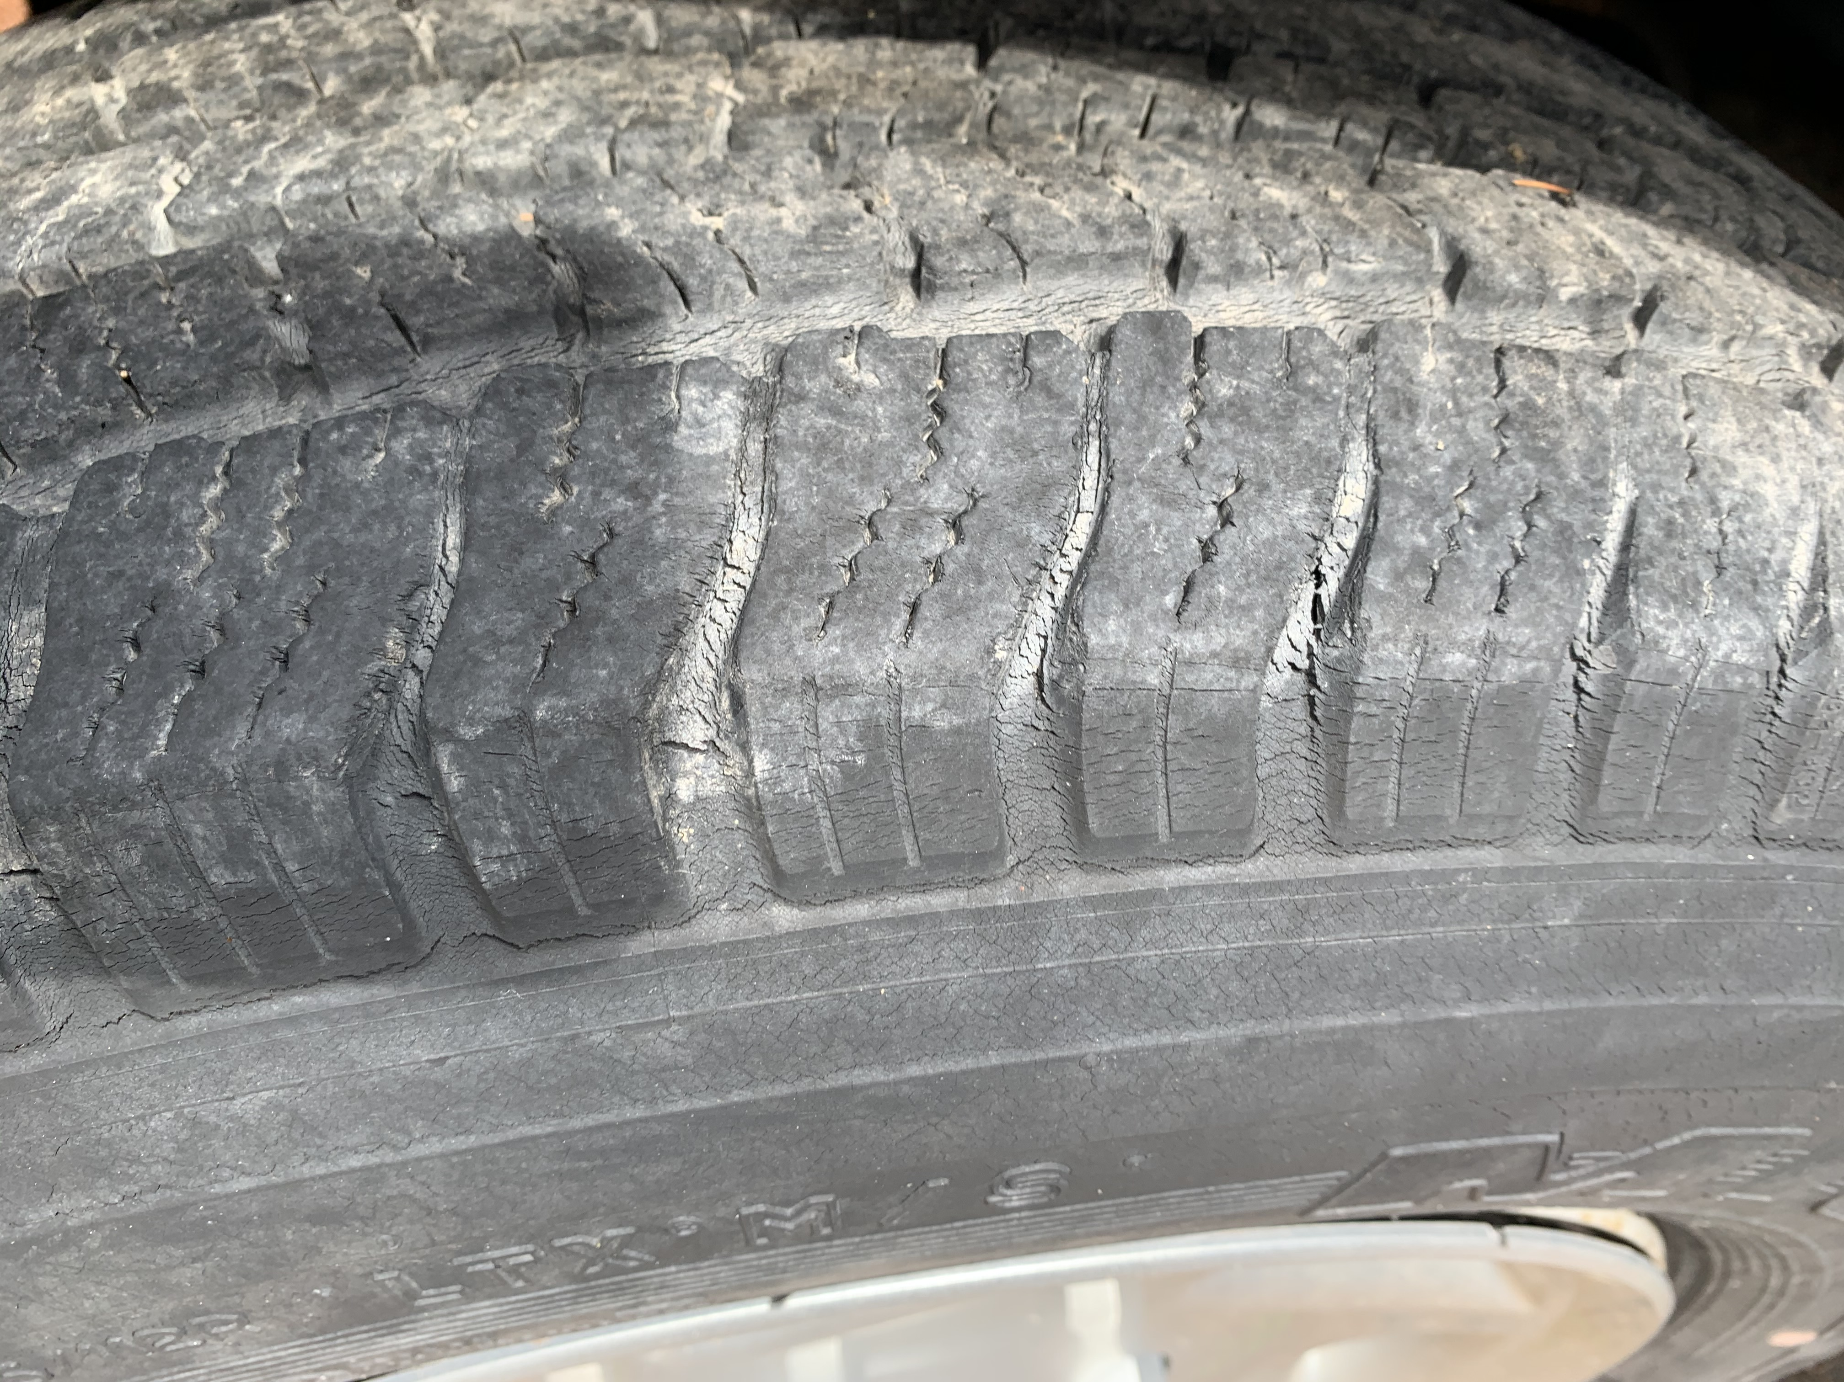
Inspection and maintenance check
Ensure enough time to inspect the vehicle, check previous write-ups are corrected, and to correct minor issues. Day before, perhaps?
Pay close attention to tires, especially inflation.
Proper Inflation
Check for cracking between tread and area that wear tread attaches to tire body
Imbedded objects
Uneven tire wear
Notes:
It is not uncommon to show up to inspect the van 30 minutes prior to leaving for an event and discover the tire pressure is low. Make sure you leave time to find high pressure air to top off the tires or have a compressor available.
Make sure safety equipment is available and in working condition. Water? Food? Blankets or hand/foot warmers in the winter? Check the pressure and condition of the spare tire. It is a good idea to inspect the vehicle the day before so you have time to correct any issues or arrange alternate transportation.

Slide 6
Inspection and maintenance check
This tire was inspected two weeks prior and had proper inflation and no defects noted. The vehicle had not moved since the inspection. Imagine the results at highway speeds with a load of cadets!
The cause was age related degeneration. The tire was manufactured 10 years prior to this event. Tires must now be removed after six (6) years time in service.

Slide 7
Inspection and maintenance check (tire age)
Tire age is found coded, molded into the sidewall
Look for the DOT, then move right to find 4 digits circled. The digits indicate the week and year of manufacture. In this case 2118 is the 21st week of 2018.
CAPR 77-1 requires tires to be replaced at six years of age

Slide 8
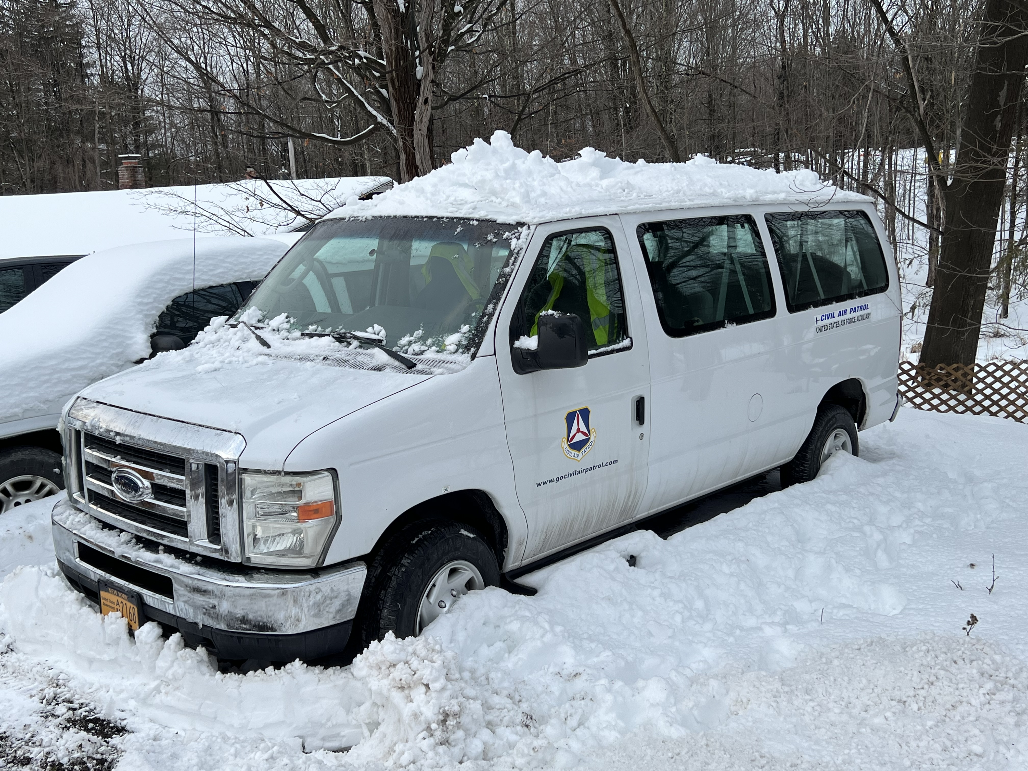
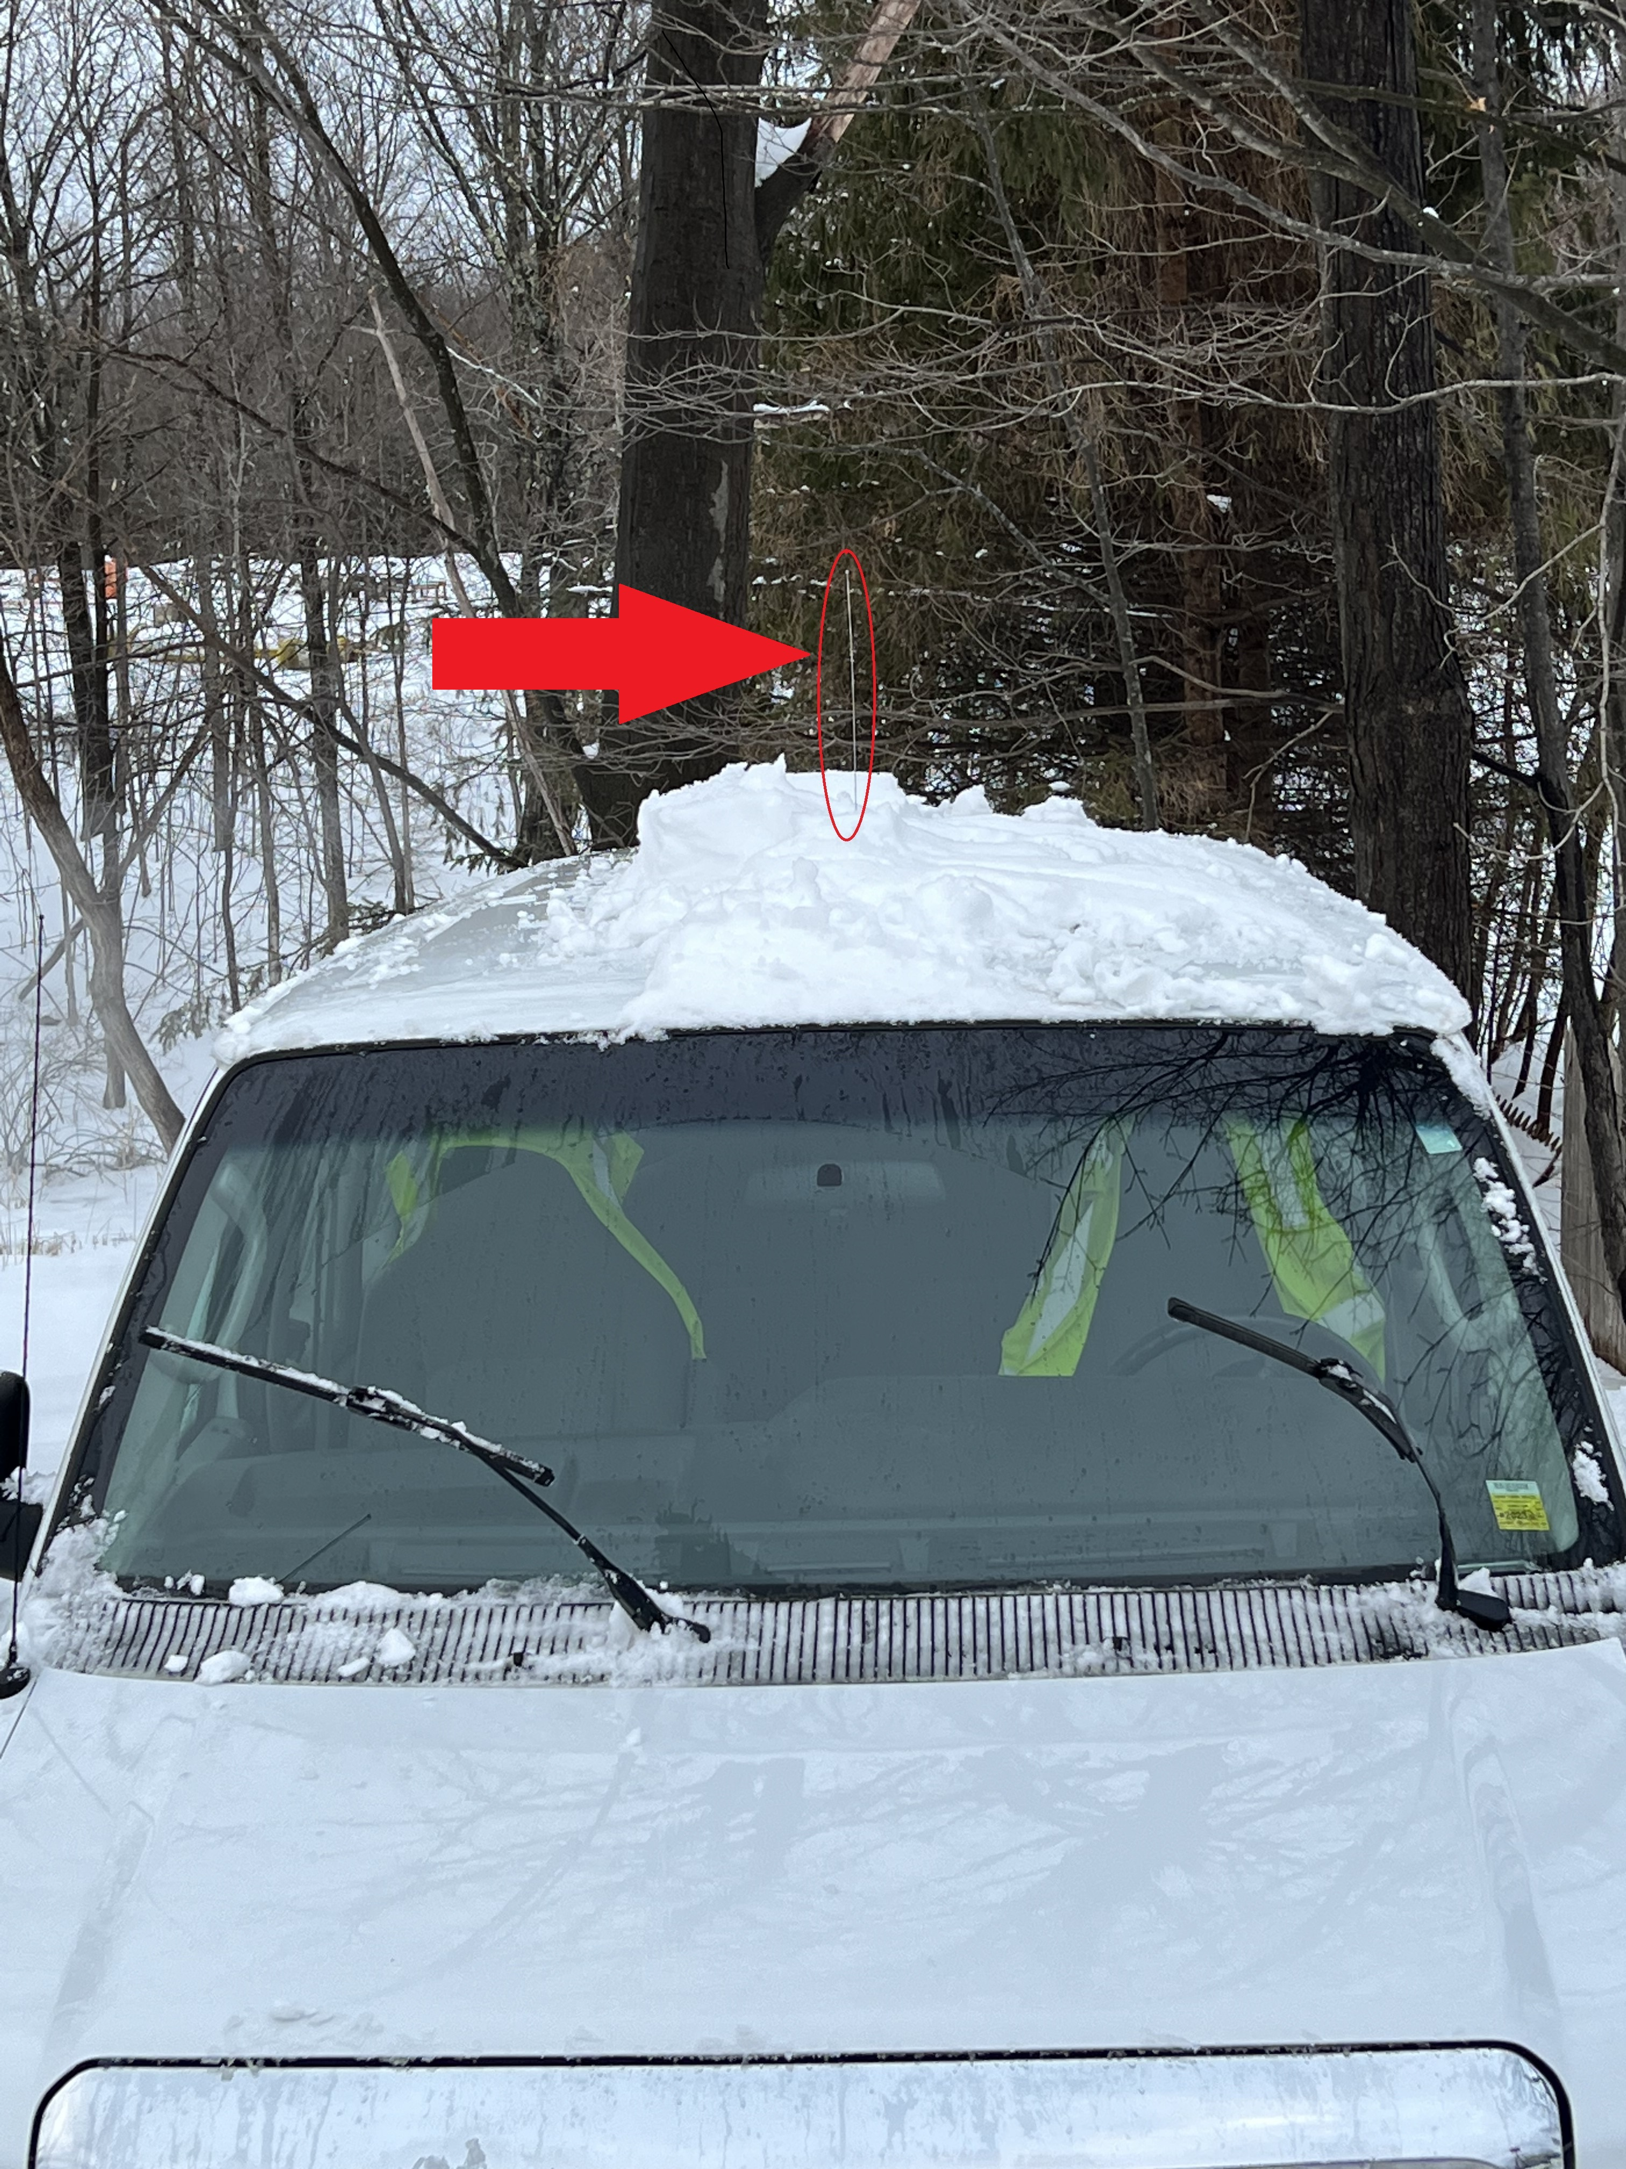
In the winter, leave time to clean the snow off the van.
Don’t drive over snow piles
Not Ready Yet
Watch the Antenna!
Notes:
Don’t drive over snow piles or drifts. The snow may hold ice or other obstructions which could damage the underside of the van. Be very aware of the antenna location when removing ice and snow. The antenna can easily break off.

Slide 9
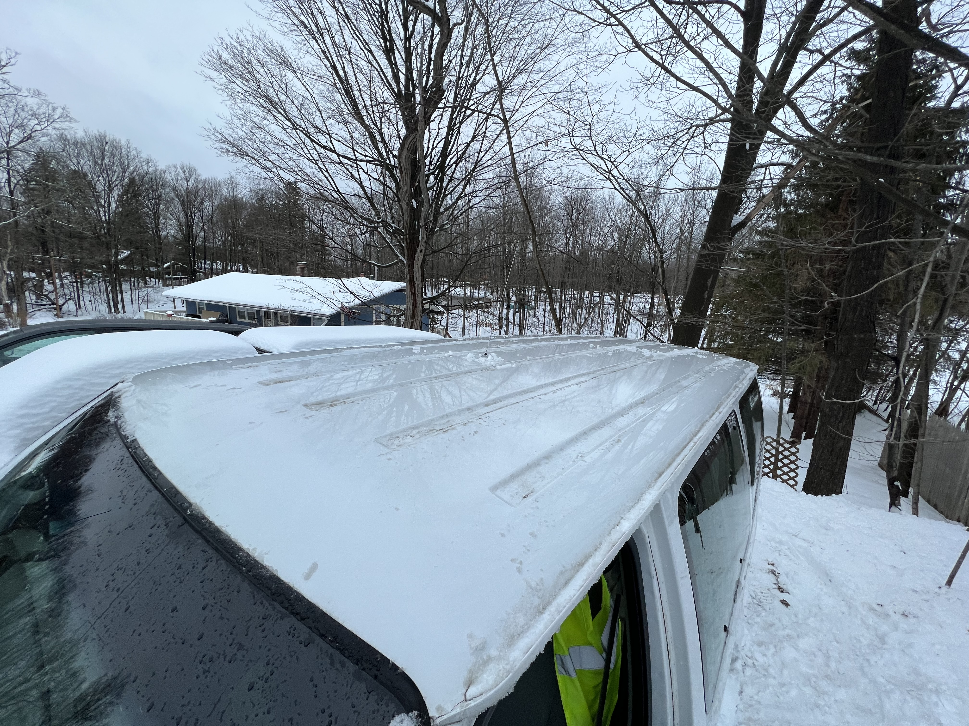
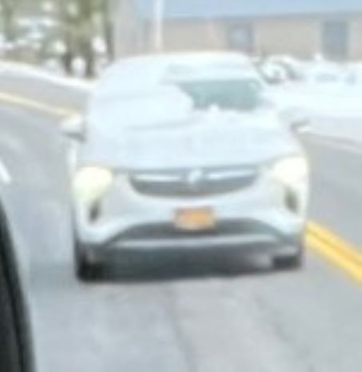
In the winter, leave time to clean the snow off the van
Ensure all lights are clear including upper stop light
Good to go-no snow/ice on roof to fly off, antenna still attached!
Don’t be this guy! (Actual pic Maj Neal took-while I drove.
Notes:
Do not leave any ice or snow on the roof which could fly off enroute causing a serious accident and opening up liability for CAP. Remember there is a banner on the side proclaiming who the van belongs to

Slide 10
Rules of the road
Follow ALL state and CAP laws and regulations
No alcohol use within 8 hours of driving CAP van
Comply with CAPR 77-1 Duty time limits
Lights on while operating the van
Driver will not use hand held phone or operate GPS when driving
Use spotters when backing up or maneuvering in tight spaces
Use a Navigator/communicator in the right seat to operate GPS, advise of upcoming turns and answer cell phone/radio
Cruise in right lane, use flashers if traffic too fast
Move over and slow down for emergency vehicles.
Notes:
Just because traffic is going 70mph, and you are in a 55mph zone, do not speed. Travel in the right lane and use flashers if you feel threatened. You have the law as well as CAP regulations to back you up. If you are caught speeding, you are on your own as well as showing CAP in a bad light. The USAF is very serious about speed limits.

Slide 11
The paperwork
Inspect vehicle and sign off in appropriate spot, before departing
1st Driver signs vehicle log in appropriate spot
Input whole hours in correct usage column. Round up to the nearest hour. Time is the time at the activity, NOT driving time.
i.e. If you depart to a museum at 0715, arrive at 0932, depart at 1630, and arrive at 1845, usage is 12 hours under cadet activity. Not 6 hours drive time.
Make sure to enter any discrepancies and inform the maint. officer
Top off the van upon return, or if too late arrange refueling ASAP.
Notes:
Remember that the trip is not complete until the van is refueled, cleaned, and van log complete. Also complete the CAPF 109 if required and upload data to WIMRs. Commanders should be kept informed of arrival at the destination and intermediate stops.

Slide 12
The Good Passenger
Be early to help prepare and inspect vehicle under supervision of driver. (cadets cannot do any inspection items requiring them to be behind the wheel, such as activating back-up horn, starting vehicle etc)
Most senior officer or cadet not driving will control passengers
Seatbelts must be worn from prior to start until vehicle shut off
No Horseplay! No moving around inside vehicle while in motion
Communicate or listen to music quietly so as to not distract driver
Become a trained spotter/director. When changing lanes assist in watching for traffic in blind spots
Notes:
As a passenger, use the time to prepare for the mission ahead. Get some rest, eat a light meal, pre-hydrate and mentally prepare for your duties at the destination.

Slide 13
Backing and parking
Driver must use a spotter trained in directing if they are available
The following slides show recommended hand signals to direct van during backing up
DO NOT STAND DIRECTLY BEHIND VAN! Director MUST see drivers eyes in the mirror at all times when directing, driver must see director in mirror at all times or STOP vehicle

Slide 14
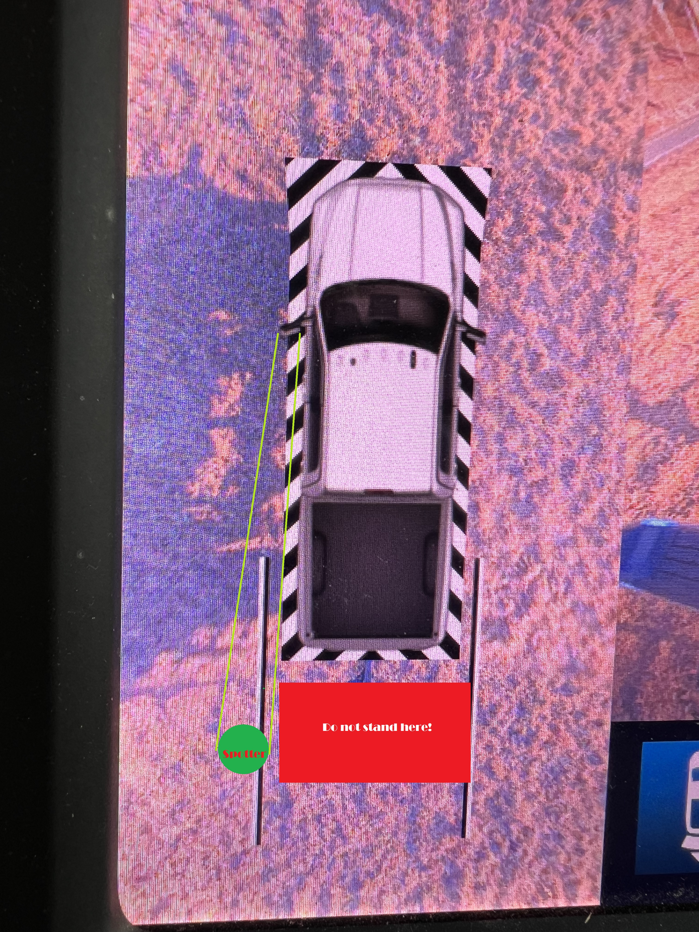
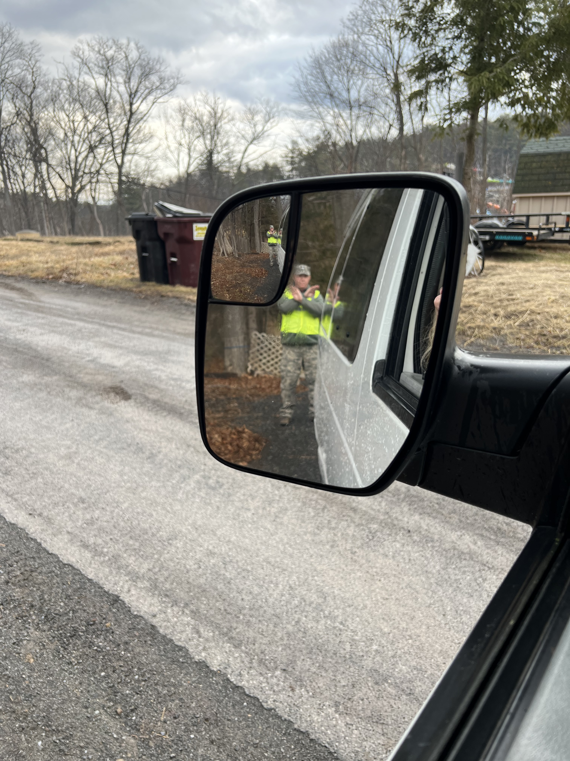
Backing and parking
Driver sees spotter
Spotter sees driver
Spotter in correct position
Notes:
Driver and spotter should discuss the plan for moving the van, then have the spotter deploy to complete the operation safely. AT NO TIME should the spotter get behind the vehicle. The spotter should move to keep the driver’s eyes in view in the driver side mirror.

Slide 15
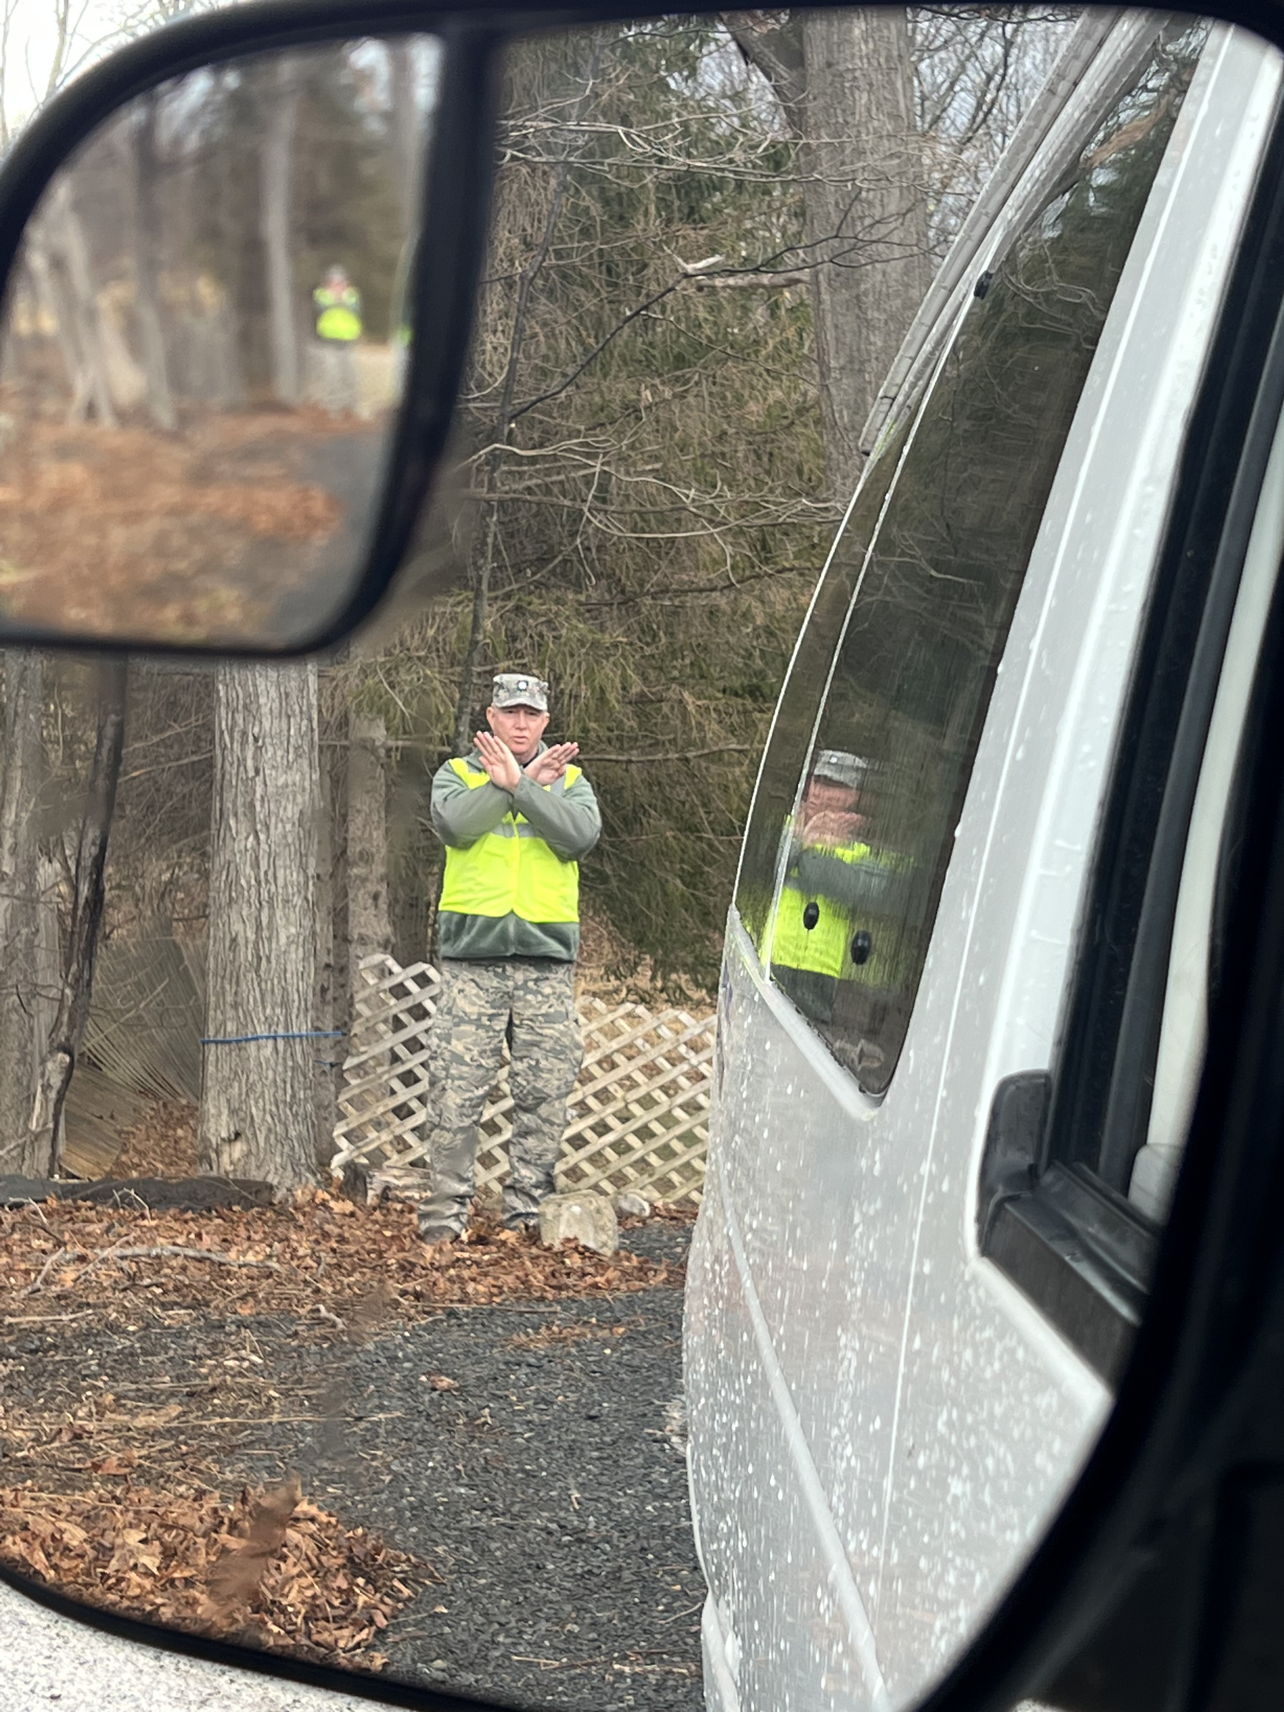
Backing and parking signals
To back up straight-both arms motion
Vehicle backwards
To stop vehicle-forearms crossed
Be sure to leave time for driver to react, leave space for rear doors to open if required

Slide 16
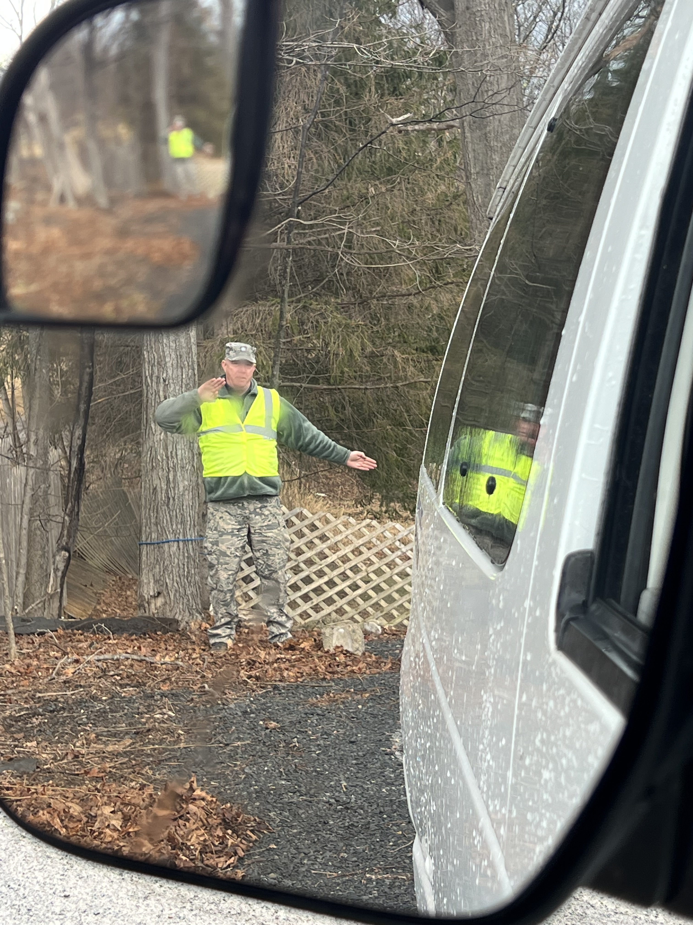
Backing and parking signals
Outstretched arm indicates direction to move rear of vehicle.
Back to your left
Back to your right

Slide 17
Backing and parking signals
Not A GOOD SPOTTER!
DON’T BE THAT GUY!

Slide 18
Lane changes and turns
CAP vans are much larger than most personnel vehicles
There are large blind areas to be aware of when changing lanes
Move head around and utilize passengers to assist in verifying the lane is clear prior to moving into a new lane. Utilize your turn signal early in the process
When making turns on city streets or tight spaces with obstacles like fences or guard rails, make a wide turn, remember all of the van forward of the rear tires will displace into the turn, the van aft of the rear tires displaces opposite the turn.

Slide 19
Turning right going through a gate
When turning in confined spaces, move forward until the rear tires are almost even with the threat then turn.

Slide 20
Navigation and communications
As assigned driver, familiarize yourself with the route ahead of the trip
The person in the right seat should be Navigator, working the GPS or maps. Keep the driver informed of position and upcoming turns and tolls etc.
Right seat or another assigned person should handle communications. Driver DOES NOT talk on the phone and should not operate radio unless alone in the vehicle.

Slide 21
Distractions
The senior officer or cadet should take a leadership role and keep background noise from occupants and radios etc to a low level to prevent distracting the driver
Should the senior member in charge need to get the attention of the group, DO NOT SCREAM so as to startle the driver. Use a firm, authoritative voice but a moderate volume only
Keep driver aware of any hazards such as approaching trucks ets.
A safe trip is the responsibility of all personnel on board plus those supervising the trip from afar, such as the safety officer and commander.

