Slide 1
Power of Position
A primer on the Importance of Correct Seat and Feet Positioning
By
Lt Col Sean Neal, CAP

Slide 2
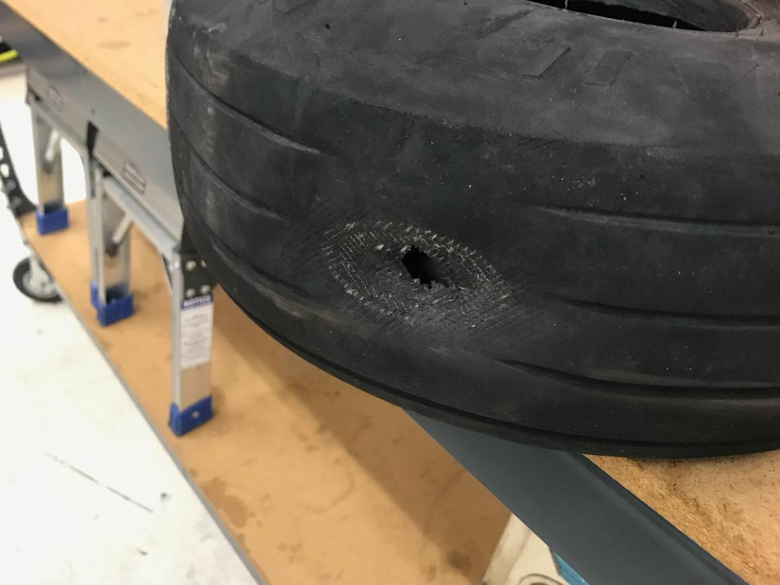
Why does it Matter?
A review of incidents has shown that pilots have been inadvertently applying brakes and/or undesired rudder inputs that have caused, shall we say, some unplanned events or excursions.
In the absence of evidence of mechanical failure or lack of skill or currency, seating/foot positioning seems to be the likely cause.
In 42 years as an instructor, I have noticed that this subject is often not emphasized or even ever brought up in initial or follow on training.

Slide 3
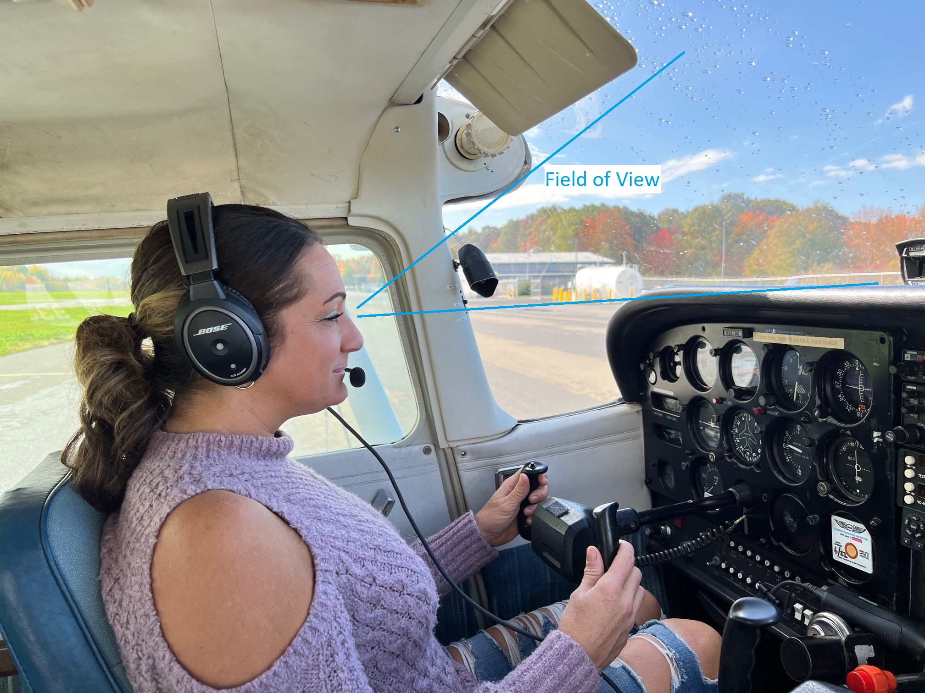
The Correct Position
The correct positioning of the seat will allow maximum field of view, best position to operate controls, and help avoid unwanted inputs while providing full control movement.
In this case, the pilot is too low in the seat. The eyes should be 1/3-1/2 way up in the wind screen. This allows optimum field of view while providing the best depth perception. The seat should be raised or cushions added.
Notes:
Pilots sitting too low will have poor depth perception. They will also tend to focus close to the aircraft by looking out the side windows. This often leads to pilots not seeing check points or the destination until very close and will be more reactionary on cross country flights instead of having their minds ahead of the aircraft. Proper seat height will allow pilots to see and recognize points well ahead of the aircraft encouraging them to plan and fly ahead of the aircraft.

Slide 4
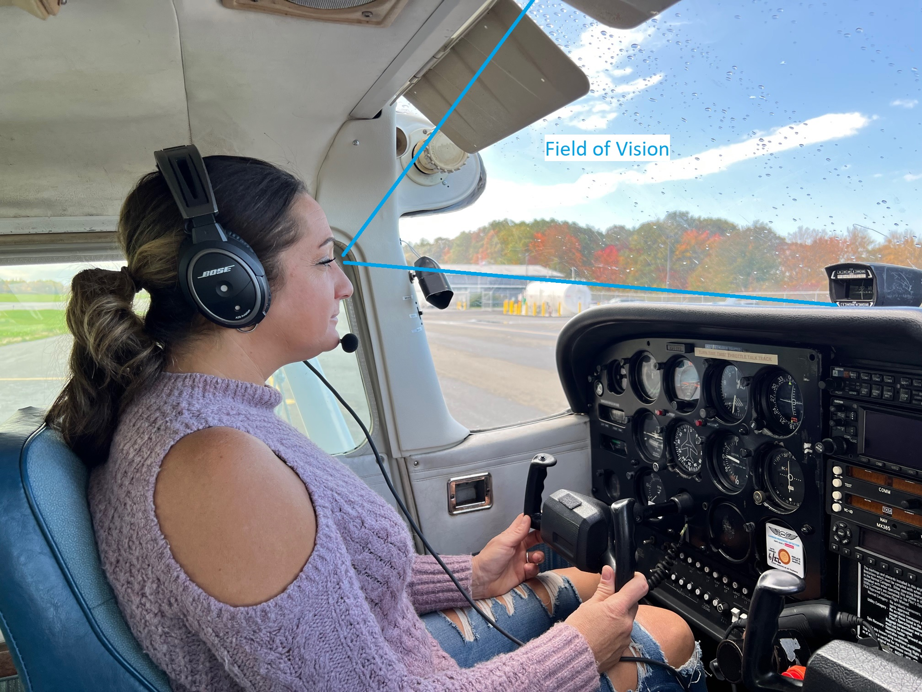
Correct Seat Height
In this picture, the pilot is situated at the optimum height. For the Cessnas, the eyes should end up just below (perhaps 1 inch ) the top of the side window frame. There is no need to be lower due to the wing restricting vision upward.
The pilot is high enough to have good forward visibility and depth perception.
Notes:
Manufacturers of large aircraft believe seat position is so important that they include a device to align the seat at the proper height and fore/aft position. This provides optimum field of view and also a consistent sight picture.

Slide 5
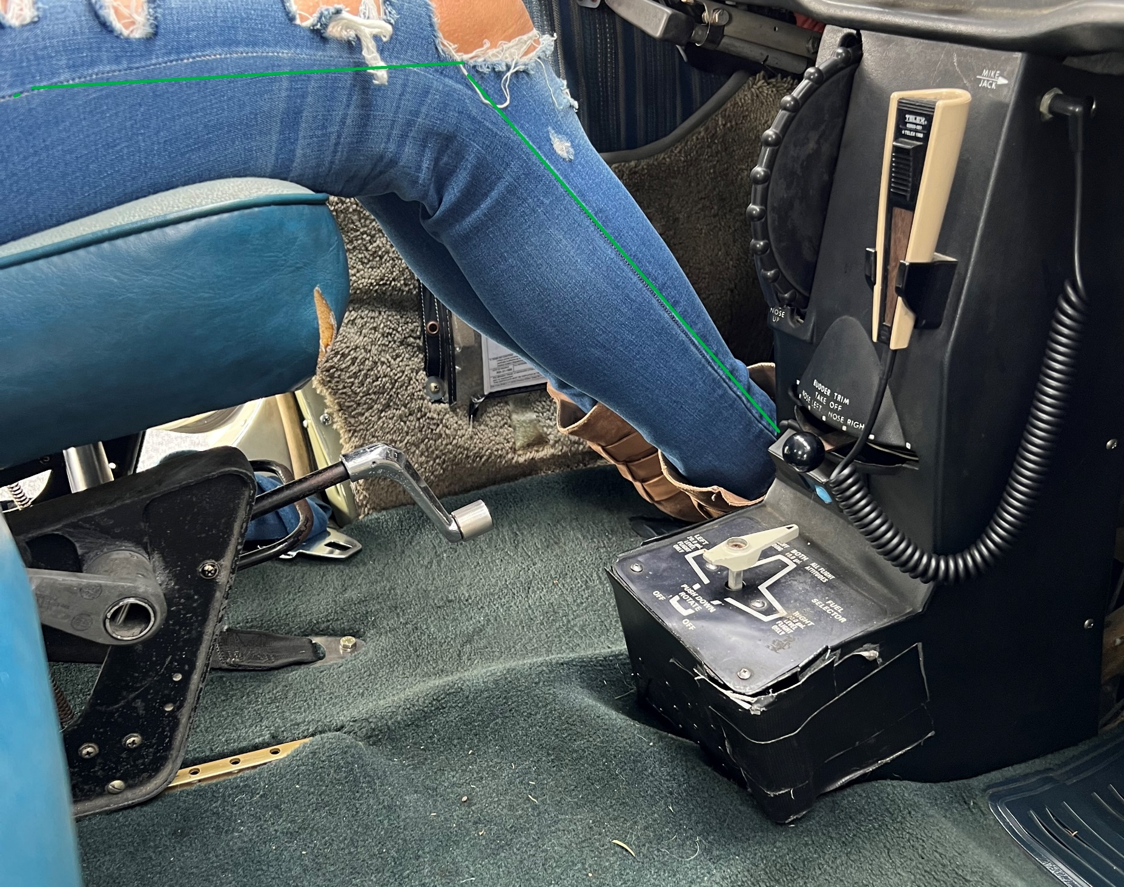
Seat Track Position
The seat should be positioned close enough to the rudders to allow full travel without stretching but not so close as to have the feet jammed up against the pedals.
Too far away and the risk is not getting full travel as well as potential unintentional brake application.
Too near and it is easy to over control the pedals or apply brakes.
As seen here, the knees should be bent about 45 to 60 degrees

Slide 6
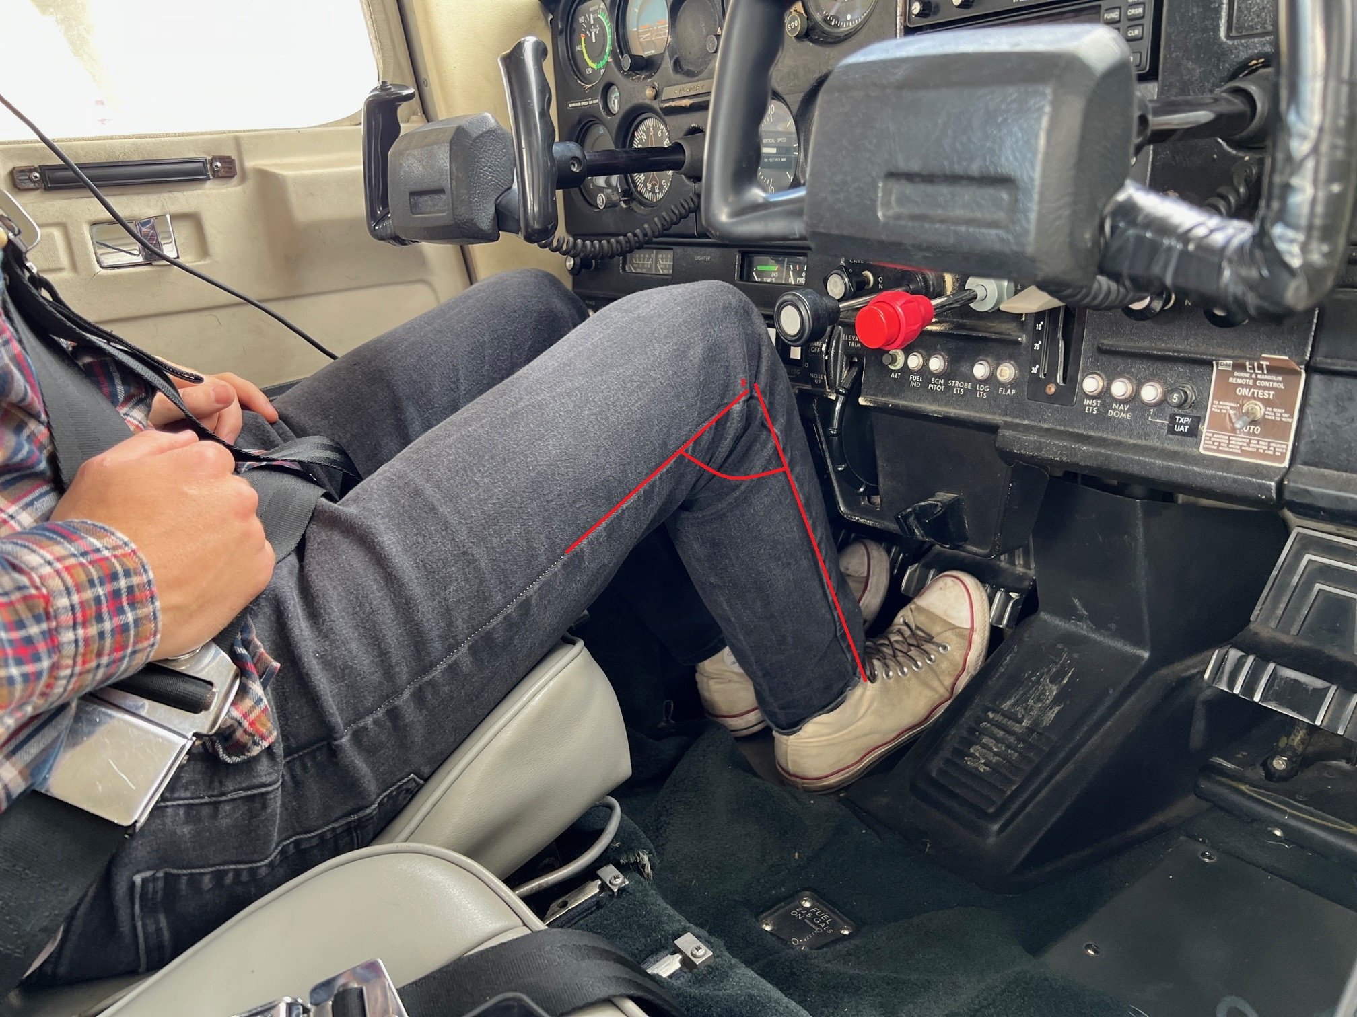
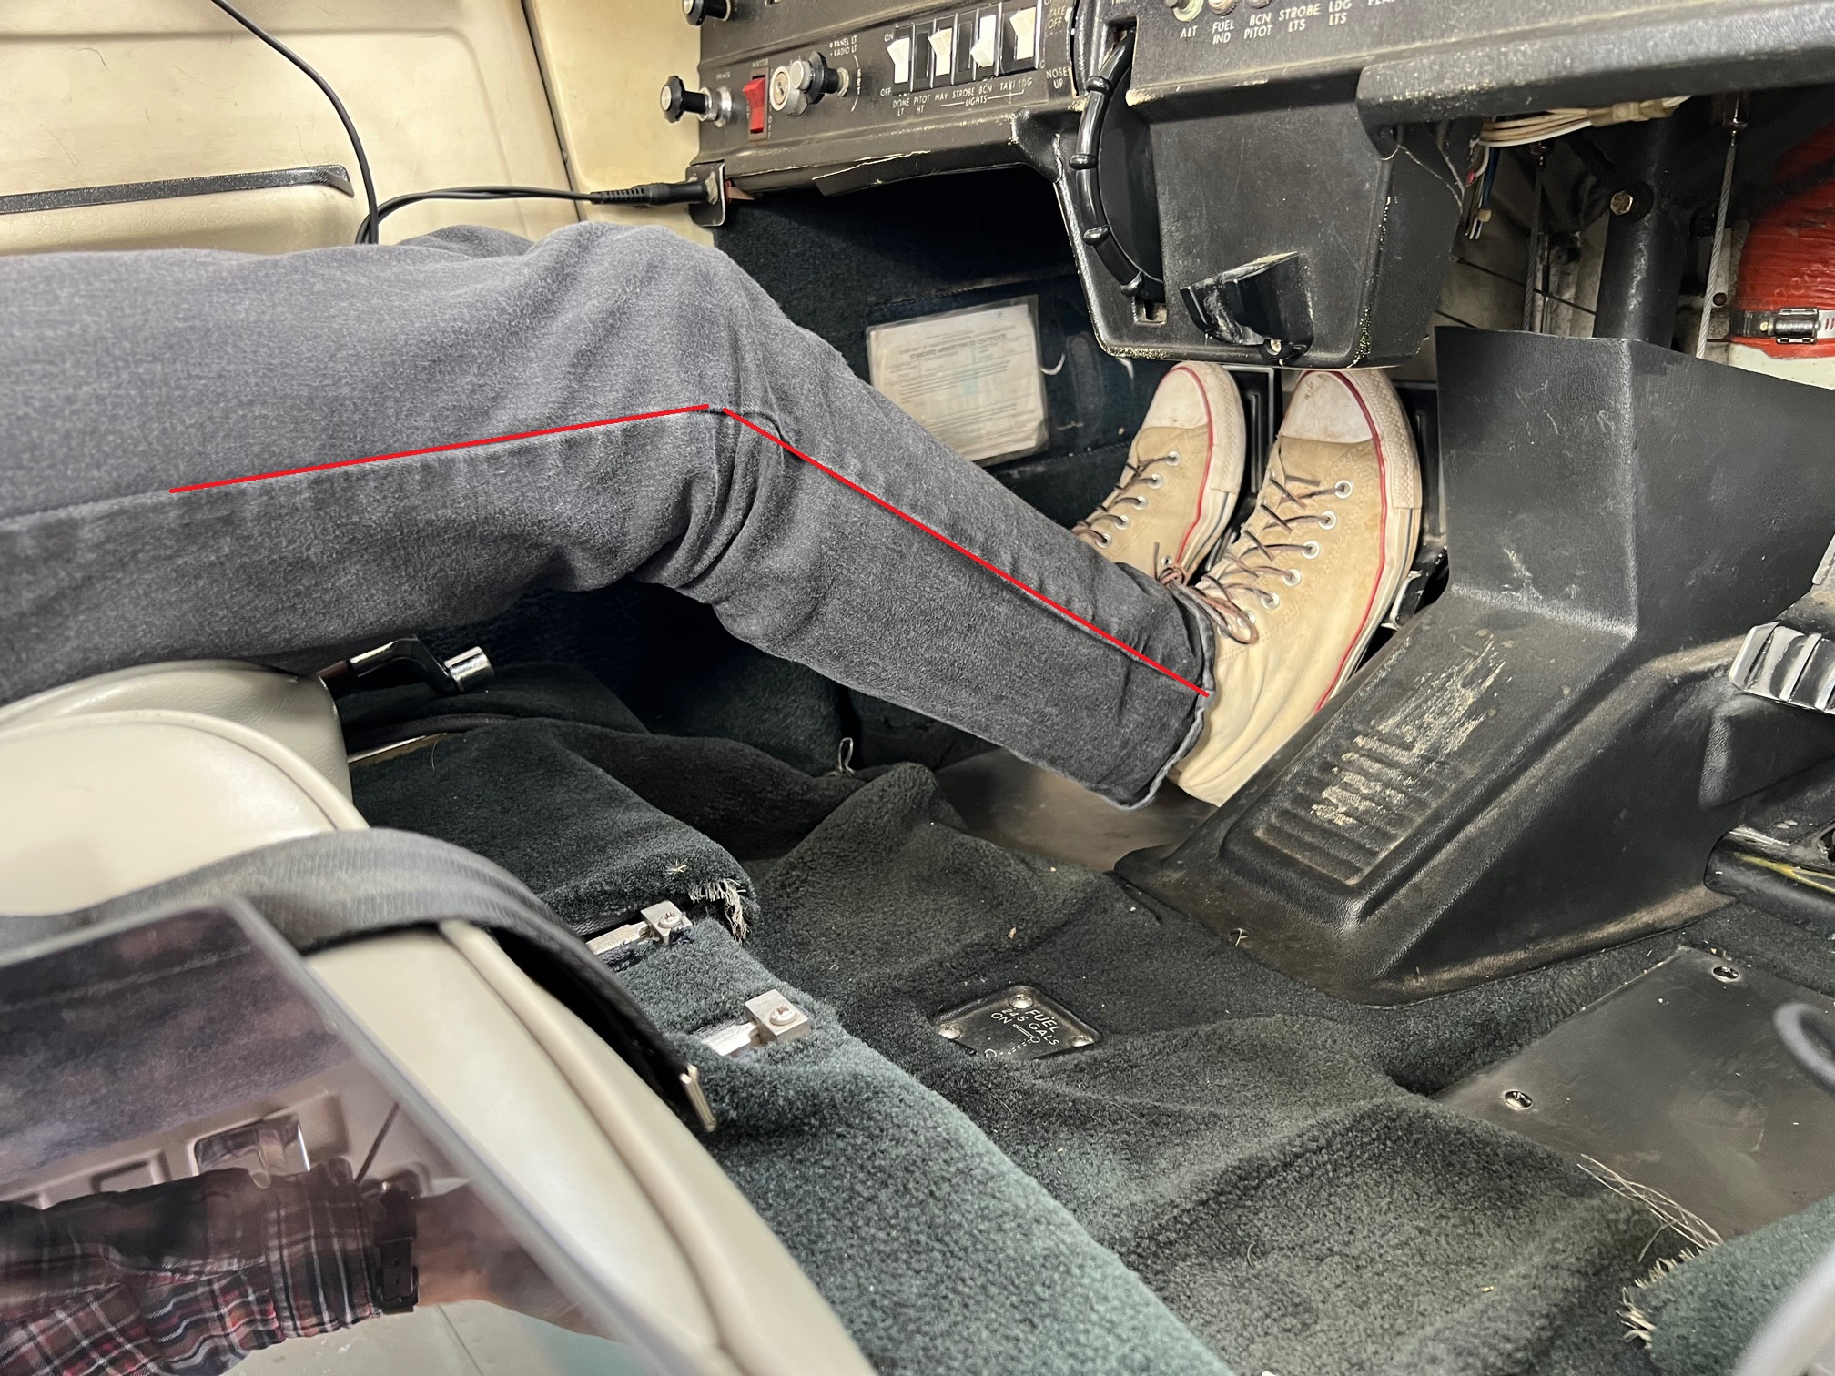
Seat Track Positions
Too close to the rudder pedals
Knees bent >45 degrees
Too far back from the rudder pedals
Knees bent <45 degrees
Notes:
In the picture on the left, the pilot will likely over control the rudders/brakes. On the right, the pilot may have issues getting enough rudder deflection/brake application.

Slide 7
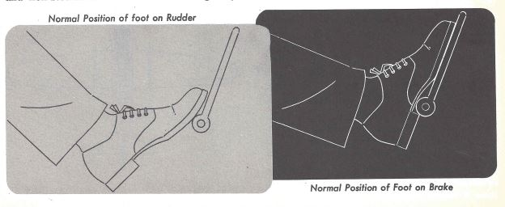
The foot rest
The normal position of the foot on the rudder pedals is heels on the floor with toes or ball of foot on bottom of pedal.
Only raise feet up to actually actuate the brakes. Failure to do this leads to dragging brakes and less ability to use rudder correctly.
If the foot is too high, one must overcome the inertia of the entire leg to move the pedal vs just the toes.

Slide 8

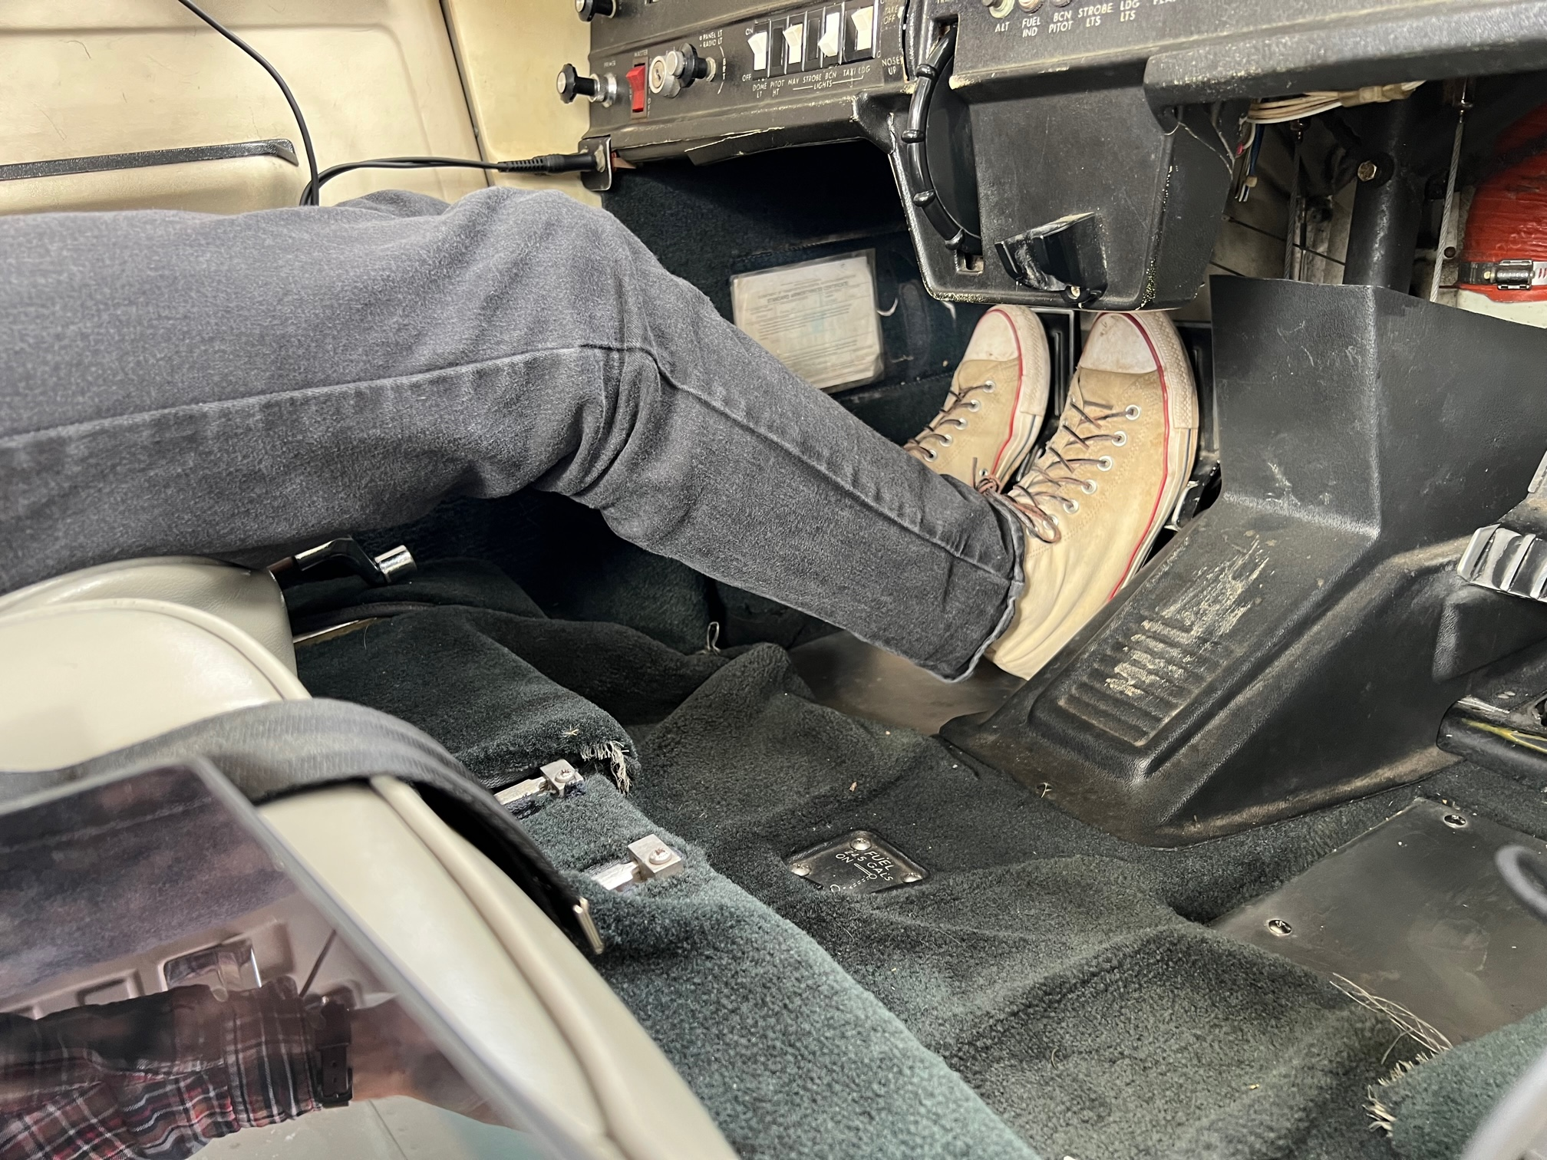
Taxi and In Flight vs Applying Brakes
Proper foot position in flight and during taxi-use throttle for speed control during taxi. Use brakes to tighten turns, stop, control weather vane, (seat shown too far forward)
Foot position during application of brakes
On landing, use brakes as you approach taxi speed unless absolutely required due to field length

Slide 9
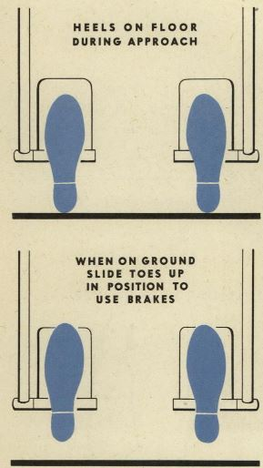
Take aways
Proper seat positioning allows:
Best field of view
Full movement of controls
Lower chance of inadvertent or
excessive movement of control
Proper foot Positioning allows:
Full rudder movement
Prevents inadvertent brake application during takeoff and landings

Slide 10
Instructors and Check Pilots
1. Visually verify pilot’s foot position during taxi
2. During taxi, ensure pilot uses throttle for speed, and brakes sparingly. No lurching should be felt during taxi due to dragging brakes.
3. After takeoff, ensure tires continue to spin down and do not stop abruptly.
4. In flight, visually verify heels on the floor, ball of foot/toes on pedals
5. During approach/prior to landing, ensure pilot’s heels on floor, toes on pedals.
6. On short field landings, evaluate proper technique but do not demand max performance. Leave plenty of safety room both prior to touchdown and rollout.
7. After landing, do not move flaps etc. unless REQUIRED by procedure.
8. If not current or proficient, start with full stop/stop and go, then progress to touch and go patterns.
Notes:
Note #7 above. It has been shown that moving one side of the body (such as reaching for flaps, cowl flaps etc with the right hand ) can produce a tensing/flexing of muscles on the opposite side of the body such as the leg/foot. This could be the cause of SOME left swerve incidents where left rudder/brake may be inadvertently applied during a touch and go landing.

